Slide 1

IS613:Database management system

Slide 2

Project on Restaurant management system

Slide 3




Meet the team
Jinesh Khatiya​
Vedant mandre
Yuvraja kadari
Mahesh kate

Slide 4
abstract:
In many popular restaurants, waiters/waitresses tend to miss out on tables or customers’ calls during busy hours potentially decreasing one’s client. While this is an ongoing issue, there is still no product that drastically improves communication between the servers and the customers in the current market. Hence, the goal is to design a system (Database Architecture) in which the customers can connect with servers easily and help the restaurant increase overall efficiency.
An internal wired communication system will allow prompt notification to the server when a customer requires service. Moreover, servers can also be more focused on serving their current customers and save their time and energy by always keeping an eye out for needy customers.
On top of meeting the needs of customers, restaurant managers can also monitor the response time of their waiters/waitresses through use of this system. Hardworking, proficient employees will become more recognized while lazy, inefficient employees become motivated to improve. As a result, the restaurant has become more efficient and possibly increasing morale while improving the level of customer satisfaction.

Slide 5

Problem statement:
Inventory management:
Sales Tracking:
Efficiency:
Restaurants order new stock of food every week and there is a need to maintain this heavy inventory.
Restaurant managers can keep track of sales in a financial year and implement a business strategy for the next financial year.
Traditional way of keeping huge handwritten data of everything makes the system less efficient.
Communication:
Usability:
Lack of communication between customers and restaurant employees while giving or receiving orders.
Service industry professionals want something that’s easy to adopt and simple to use for their restaurant​.

Slide 6

Business needs:
Inventory Tracking
Online/offline order management
Easy menu access
Detailed reporting and data
​Transition from pen and paper model to a computerized model
Employee management
Integrating different modules into a single and concise module
Tracking supplier details

Slide 7
Solution
Close the gap
Easy to use
Our product makes restaurant management manageable and easy to work with.
A simple product that gives restaurants the information they need in order to make informed business decisions ​
Improving efficiency
Tracking
By implementing this system, we are able to change the way of managing data and how we look at it which in turn makes the system more efficient.
On successful implementation we were able to keep track of employees and customer details along with the inventory management and order details.

Slide 8

Data Cleaning
Step 1
Step 2
Data was uncleaned, there were many null values, extra columns and redundant values.
Conversion of data from 0 NF to 1 NF(normalization).
Step 3
Step 4
Analyzing the database and removal of extra column.
Sorting and segregating the data into their respective tables

Slide 9
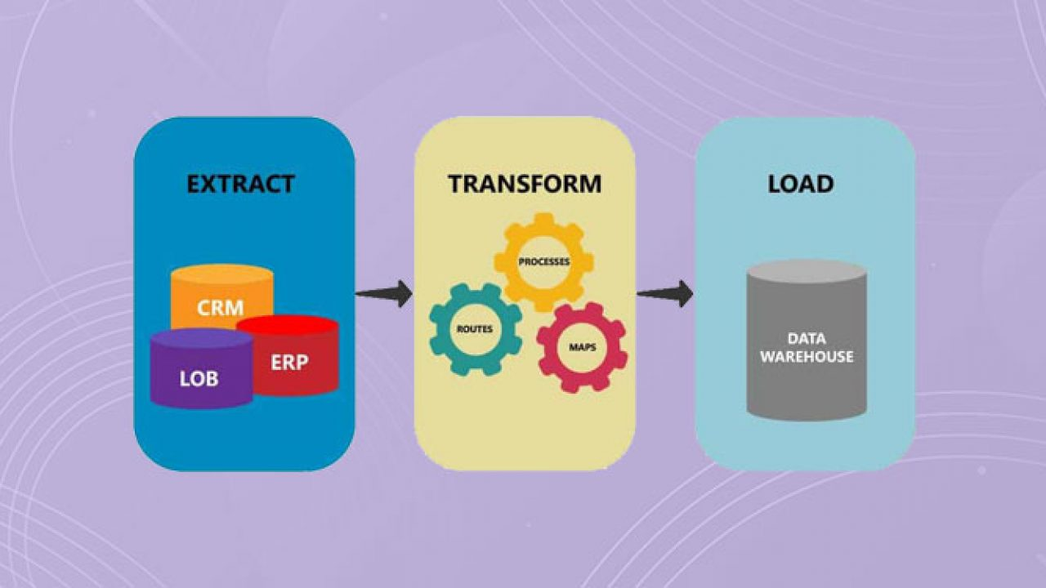
ETL(Extract, Transform, Load)
Extract:
Transform:
Data is extracted from various data sources.
Data is loaded in the target data warehouse.
Load:
Raw data that has been loaded will be finally used creating database.

Slide 10
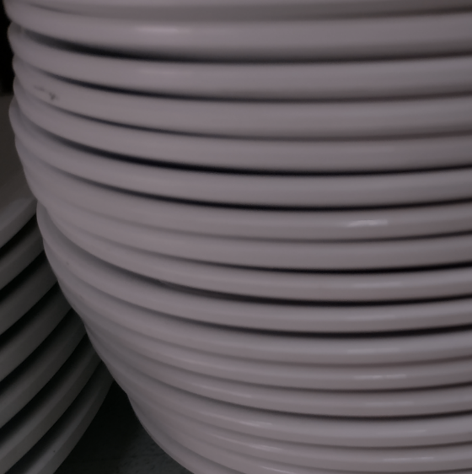
Tables list for database:
restaurant_bill
restaurant_cashier
restaurant_cook
restaurant_customer
restaurant_delivery_boy
restaurant_home_delivery
restaurant manager*
restaurant_menu_new
restaurant_owner
restaurant_restaurant
restaurant_sale _details _restaurant
restaurant_stock
restaurant_supplier
restaurant_user
restaurant_waiter

Slide 11
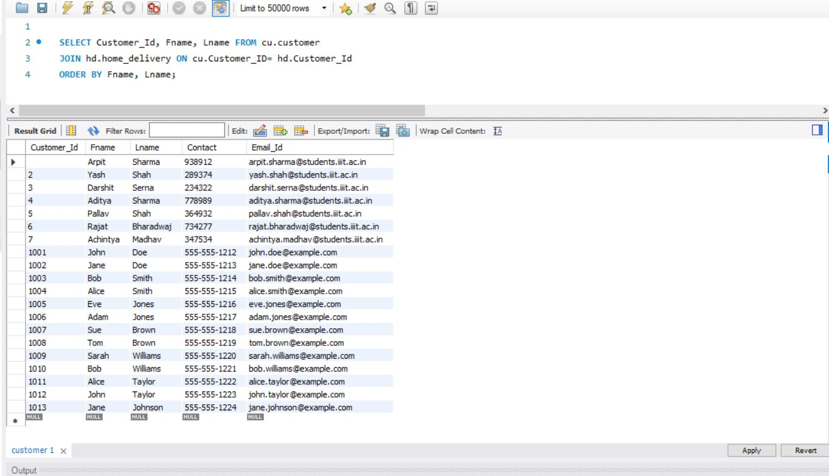
Sample query #1

Slide 12
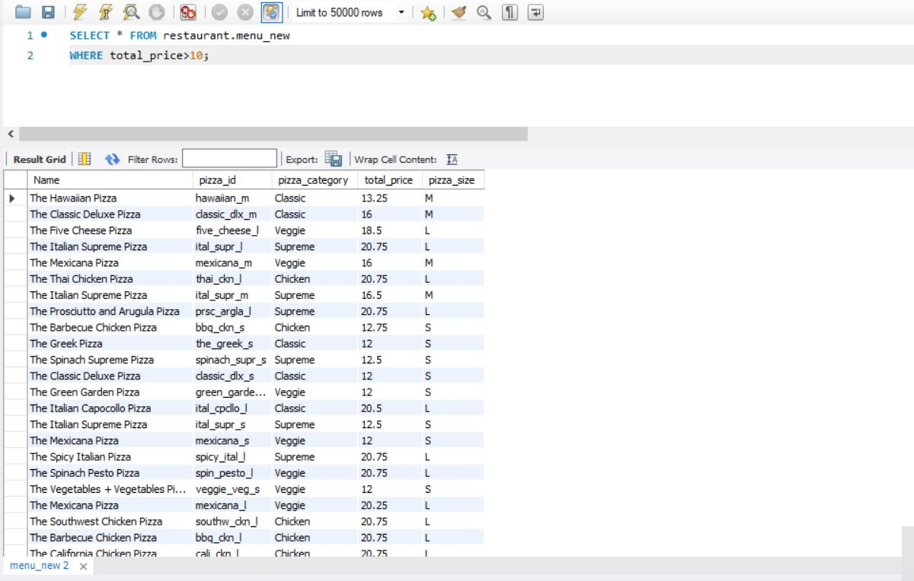
Sample query #2

Slide 13
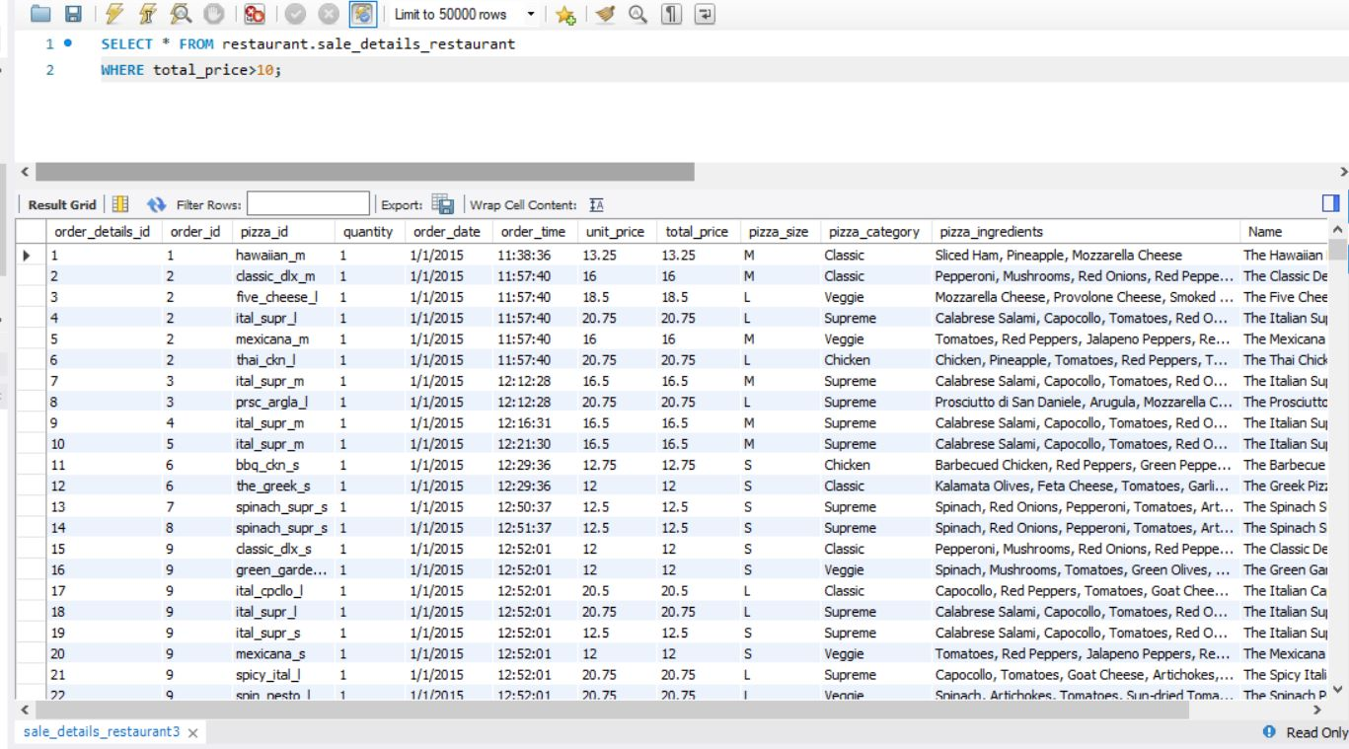
Sample query #3

Slide 14
Sample query #4

Slide 15
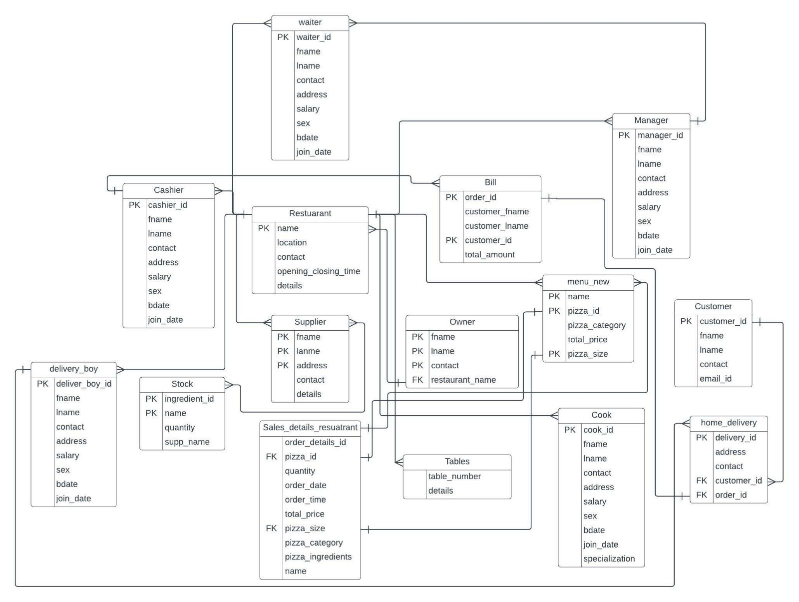
Entity relationship diagram

Slide 16

conclusion
In conclusion, a restaurant management system database project can significantly improve a restaurant's operations by centralizing data, automating tasks, and reducing errors. It can save time, increase efficiency, and enhance customer satisfaction. Investing in a restaurant management system is a wise decision for any restaurant looking to optimize its business.

Slide 17
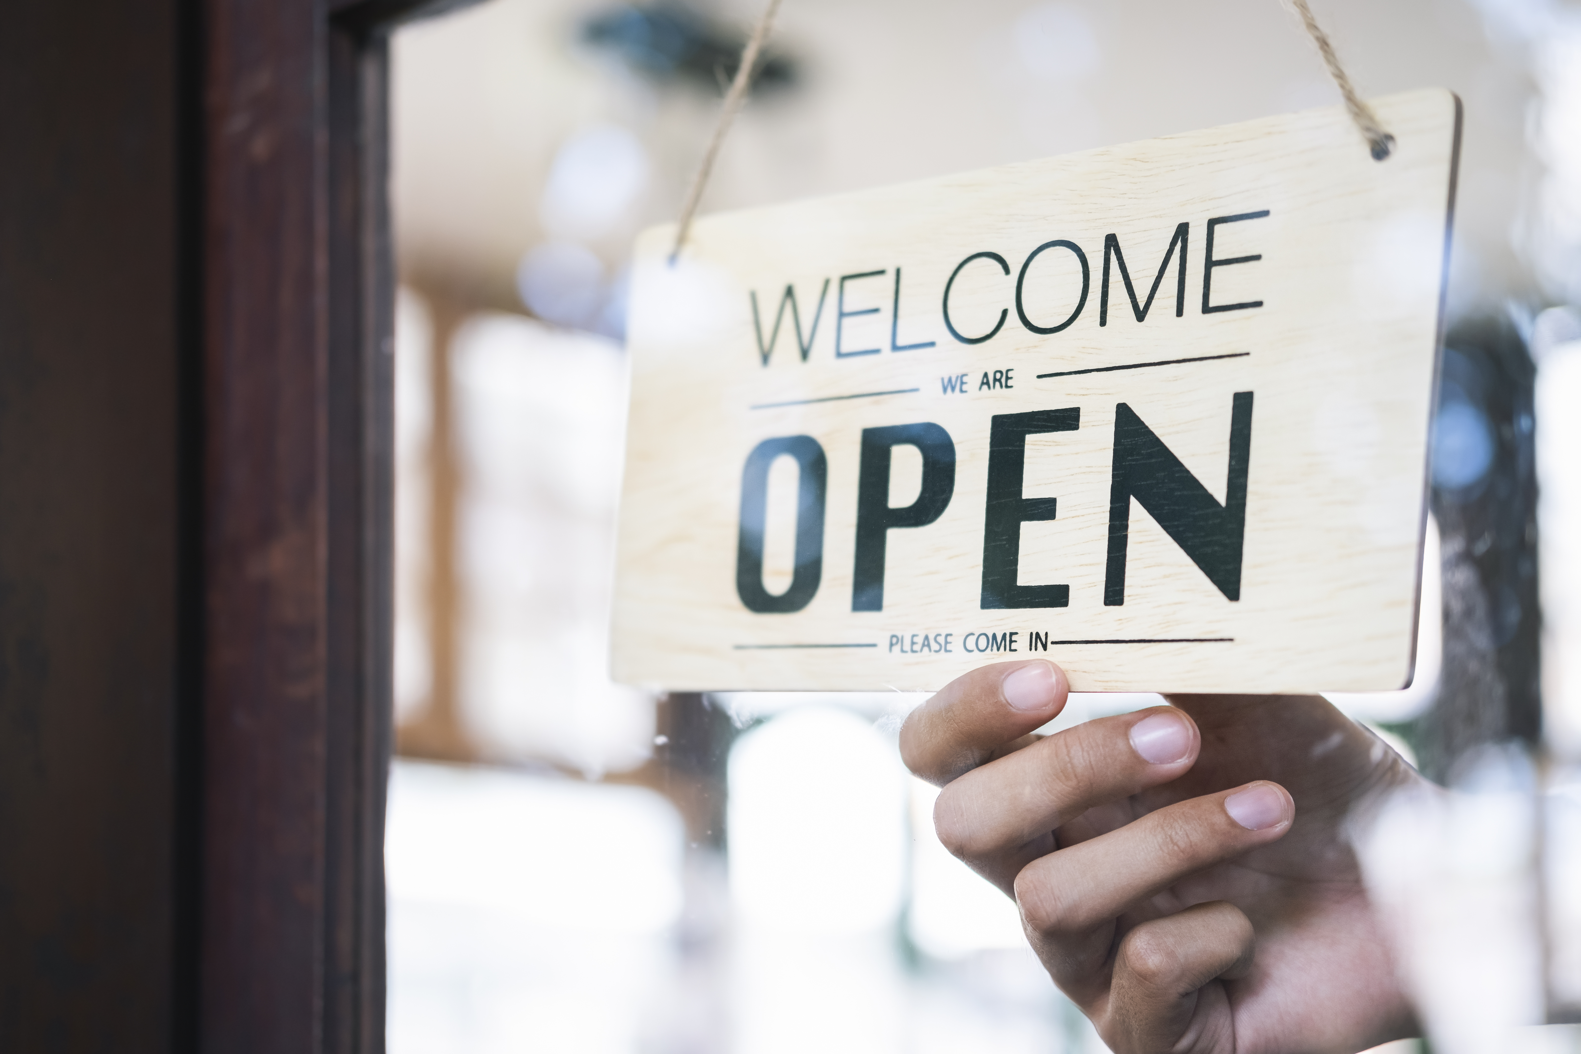
Thank You!

